Slide 1
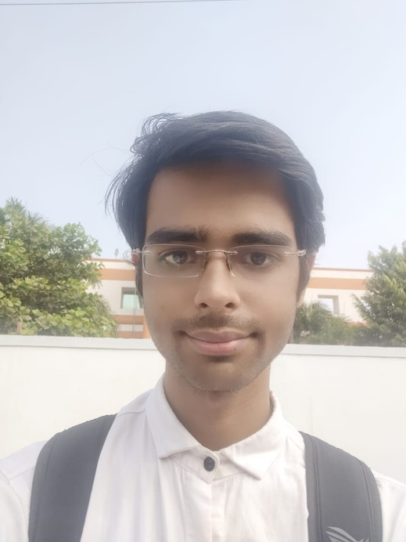
Student’s Details :
Name - Aman Singh
SkillsBuild Email id - singh4444aman@gmail.com
College Name- Rungta College of Engineering and Technology, Bhilai
College State - Chhattisgarh
Internship Domain/ Start and End Date - CyberSecurity / 13 October2023 to 26 November 2023

Slide 2

CYBERSECURITY AND IMAGE STEGANOGRAPHY
Hiding message in an image
Efficiency, productivity, and better results

Slide 3
01 | Project Overview
02 | Who are the end users?
03 | Solution
04 | How did you customize the project and make it your own
05 | Modeling
06 | Results
Agenda
Technology's positive, lasting impact on businesses and the workplace
07
Links

Slide 4
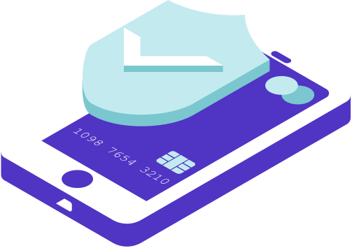
Project Overview
Steganography, the art of hiding information in plain sight, is a field that has gained significant attention in the digital age. Bit-Plane Complexity Segmentation (BPCS) Steganography is a sophisticated method in this domain, offering a robust way to conceal large amounts of data within digital images with minimal perceptual distortion. This project aims to develop and implement a BPCS steganography system, exploring its potential and limitations in digital communication and data security.

Slide 5
Who are the End Users
General Public: Suitable for individuals seeking enhanced privacy in personal communications.
Corporate Sector: Employed for confidential business communications and digital watermarking of intellectual property
Data Security Professionals: Utilized by cybersecurity firms and forensic analysts for secure data transfer and cybercrime investigations.
Government and Defense: Applied in military and intelligence operations for covert communications and counterintelligence.
Academic and Research Institutions: Beneficial for researchers in digital security and educational use in computer science and digital forensics.

Slide 6
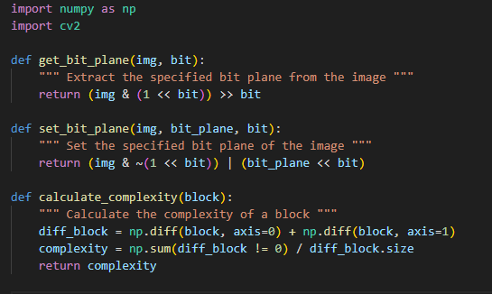
Solutions

Slide 7
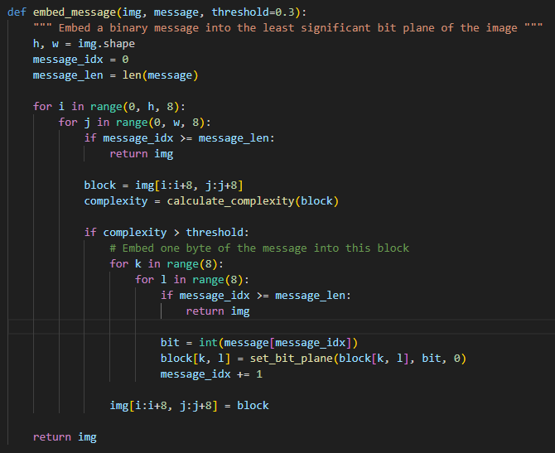
Solutions

Slide 8
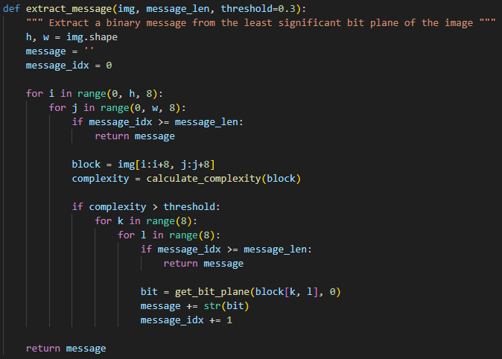
Solutions

Slide 9
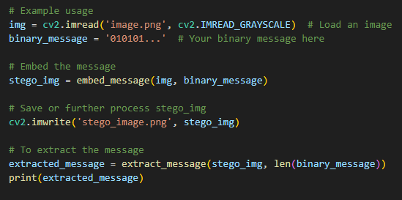
Solutions

Slide 10

How did you customize the project and make it your own
01 | Developed a unique variant of image steganography using the novel Bit-Plane Complexity Segmentation (BPCS) Steganography technique
02 | Implemented the project in multiple development environments: Visual Studio Code PyCharm Google Colab
03 | Shared the project on Discord for community engagement and feedback.
04 | Deployed the project using GitHub, ensuring accessibility and version control.
05 | Greater geographic distribution and representation of the workforce.

Slide 11
01 | Literature Review: Conduct a comprehensive review of existing literature on steganography, with a focus on BPCS techniques, to build a strong theoretical foundation.
02 | Tool Development: Design: Outline the architecture of the BPCS steganography tool, including the user interface, embedding and extraction algorithms, and error handling mechanisms. Implementation: Code the tool using a suitable programming language (e.g., Python) and libraries (e.g., OpenCV, NumPy). Testing: Perform unit testing and integration testing to ensure reliability and accuracy.
03 | Application Scenarios and Ethical Discussion: Explore real-world scenarios where BPCS steganography could be beneficial, and discuss ethical considerations, particularly regarding privacy and security.
05 | Once you're done, download your Canva Presentation in MP4 file format or get a link to your Talking Presentation and share it with others.
06 | You can also record a video inside the editor! Go to 'Uploads' and click on 'Record yourself'.
Modeling
Presenting live not your thing? No worries! Record your Canva Presentation your audience can watch at their own pace.
Don't forget to delete or hide this page before presenting.

Slide 12
04 | Experimental Analysis: Capacity Testing: Determine the maximum amount of data that can be hidden without noticeable image degradation. Robustness Testing: Assess the system's performance against image compression, scaling, cropping, and other common image processing operations. Steganalysis Resistance: Evaluate the tool's ability to withstand detection by common steganalysis techniques.
06 | You can also record a video inside the editor! Go to 'Uploads' and click on 'Record yourself'.
Modeling
Methodologies

Slide 13
01 | Enhanced Understanding of Steganography: The project has deepened our understanding of digital steganography, particularly the BPCS method, which is a sophisticated approach to hiding data within images.
02 | Advancement in Data Hiding Techniques: By implementing a unique variant of BPCS, the project contributes to the advancement of data hiding techniques, showcasing the potential for high-capacity and secure information embedding in digital media.
03 | Tool Versatility and Accessibility: The development across multiple platforms (Visual Studio Code, PyCharm, Google Colab) demonstrates the tool's versatility and ensures broader accessibility for different user groups
04 | Community Engagement and Feedback: Sharing the project on platforms like Discord has facilitated community engagement, allowing for valuable feedback, which is crucial for iterative improvement and real-world applicability.
05 | Once you're done, download your Canva Presentation in MP4 file format or get a link to your Talking Presentation and share it with others.
06 | You can also record a video inside the editor! Go to 'Uploads' and click on 'Record yourself'.
Results

Slide 14
5 | Innovation in Secure Communication: The project underscores the importance and potential of steganography in secure communications, especially in scenarios where conventional encryption might draw undue attention.
6 | Ethical and Legal Implications: By bringing attention to the capabilities of steganography, the project also highlights the need for ethical considerations and legal frameworks governing its use, especially in matters of privacy and security.
Results

Slide 15

Links
https://github.com/mvpamansingh/Image-Steganography
GitHub link :
Google Drive link :
https://drive.google.com/drive/folders/1blCMraEURyGooeCGmIP1lj5biPNTraX8?usp=sharing
https://en.wikipedia.org/wiki/BPCS-steganography#:~:text=BPCS%2Dsteganography%20(Bit%2DPlane,cover%2C%20or%20dummy%20data%22.
Resource link :
https://ieeexplore.ieee.org/document/9633914

Slide 16

THANK
YOU
:)

